Slide 1
Two Competing Theories on Financialization
Statecraft Model
Welfare states find expanding credit as an effective and efficient way to solve their fiscal and social crisis
Financialization is a contingent and periodical event that policymakers in a welfare state occasionally find the “lightness” of credits as a perfect tool to solve its crisis without huge losses and burdens
Financialization is more likely to occur in a country whose government is overwhelmed by deficits. (Fligstein 1993; Carruthers 1996; Krippner 2011; Prasad 2014; Quinn 2017; 2019)

Slide 2
Two Competing Theories on Financialization
Hegemony Model
The nature of overproduction -> credit system -> sustain the dominance and consumptive capacities
Hegemony is interpreted as a consumptive industrial country consistently having more imports than exports
When a hegemony reaches its spatial, the capital continues to expand as the accumulation of capital is unlimited and hence it encounters the problem of over-capacity. Financialization is a hegemony’s endeavor to resolve the problem of over-capacity without devaluing its dominant currency in the world market. (Harvey 1985; Arrighi 1994; Brenner 2003 )

Slide 3
Gaps in Discussions on Financialization
Focus on the United States
Inconsistent definition on financialization
This paper seeks to contribute to fill in these gaps
Clarify on the definition of financialization
Include more developed and developing countries in the discussion

Slide 4
Consistent Definition on Financialization
Three operationalized levels of financialization
Market-level: the dominance of finance industry over the real economy (Dore 2002; Epstein 2005; Wade 2005)
Corporation-level: non-financial corporations (NFCs) have become more reliant on financial channels to grasp additional profits (Stockhammer 2004; Orhangazi 2008; Krippner 2005; 2011)
Households-level: households and individuals as investors (Davis 2009; Tomaskovic-Devey and Lin 2011; Quinn 2019)

Slide 5
Hypotheses
Statecraft Model
Hypothesis 1a: The rise of financialization at the market-level is positively correlated with the growth of the domestic government spending.
Hypothesis 2a: The rise of financialization at the corporation-level is positively correlated with the growth of the domestic government spending.
Hypothesis 3a: The rise of financialization at the household-level is positively correlated with the growth of the domestic government spending.

Slide 6
Hypotheses
Hegemony Model
Hypothesis 1b: The rise of financialization at the market-level is positively correlated with the foreign trade deficits.
Hypothesis 2b: The rise of financialization at the corporation-level is positively correlated with the foreign trade deficits.
Hypothesis 3b: The rise of financialization at the household-level is positively correlated with the foreign trade deficits.

Slide 7
Inclusion of More Cases
21 countries: both OECD members and emerging economies
Australia, Brazil, Canada, Chile, People’s Republic of China, Denmark, Hungary, Iceland, Israel, Japan, Korea, Mexico, New Zealand, Norway, Poland, South Africa, Sweden, Switzerland, Turkey, United Kingdom, United States.
1960 - 2018
Data sources: OECD, World Bank, IMF’s Global Debt Database, and Historical Finance Database.

Slide 8
Method
Dependent Variable
Market-level: Value added in financial activities lag one year
Corporation-level: Nonfinancial corporate debts lag one year
Households-level: Household debts lag one year
Independent Variable
Statecraft model - domestic government spending
Government net lending, Government expenditure (current, lag1, lag2)
Hegemony model - foreign trade deficits
Net trade balance, FDI net outflows (current, lag1, lag2)
Control Variable
Real effective exchange rates (REER), Inflation rate, Broad money, GDP

Slide 9
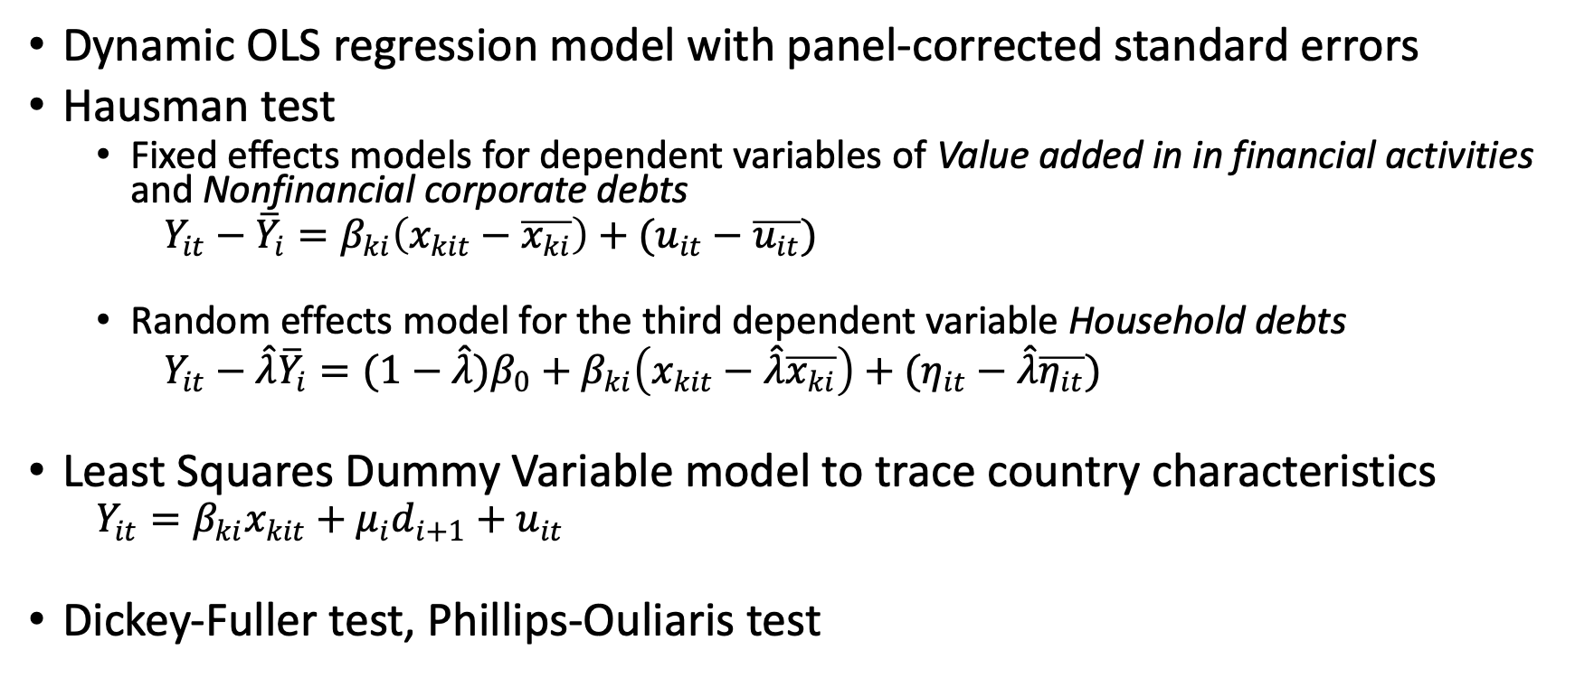
Method Continued
Dynamic OLS regression model with panel-corrected standard errors
Hausman test
Fixed effects models for dependent variables of Value added in in financial activities and Nonfinancial corporate debts
$Y_{it}−{\overline{Y}}_{i}=β_{ki}\left(x_{kit}−\overline{x_{ki}}\right)+(u_{it}−\overline{u_{it}})$
Random effects model for the third dependent variable Household debts
$Y_{it}−\hat{λ}{\overline{Y}}_{i}=(1−\hat{λ})β_{0}+β_{ki}\left(x_{kit}−\hat{λ}\overline{x_{ki}}\right)+(η_{it}−\hat{λ}\overline{η_{it}})$
Least Squares Dummy Variable model to trace country characteristics
$Y_{it}=β_{ki}x_{kit}+μ_{i}d_{i+1}+u_{it}$
Dickey-Fuller test, Phillips-Ouliaris test

Slide 10
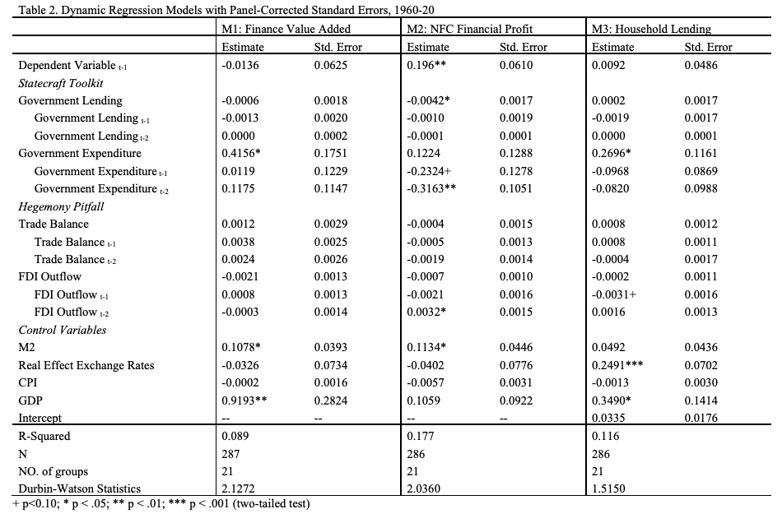

Slide 11
Results
Hypothesis 1a: The rise of financialization at the market-level is positively correlated with the growth of the domestic government spending.
→ Statecraft Model
Hypothesis 3a: The rise of financialization at the household-level is positively correlated with the growth of the domestic government spending.
→ Statecraft Model
The rise of financialization at the corporation-level is negatively correlated with the foreign trade deficits.
→ alternative to Statecraft Model

Slide 12
Conclusions
The financialization in markets, NFCs, and households is not a homogenous trajectory that always synchronize with each other.
The financialization, as an international trends, is better predicted by the rise of the governmental expenditures, instead of a country’s position in the global market.
The financialization is not a time-constant trajectory in any of the 21 countries.

Slide 13
The U.S. case: Too Much VS. Too Little
Financialization is not a phenomenon seen only in the hegemon (i.e. the U.S.) as Arrighi predicted.
However, we also simplified the concept of “hegemony” in our study but ignored how special the hegemony of the U.S. is.
This study does not challenge those case studies on the U.S. financialization from the world-system view.

Slide 14
Thank you!

